Slide 1
Legislative Briefing Material
February 2022

Slide 2
CPRIT Overview
Cancer’s Human Impact in Texas (page 3)
CPRIT’s Unique Role in the Fight Against Cancer (page 4)
CPRIT Grant Award Data (page 7)
4. Program Information
Academic Research (page 9)
Product Development Research (page12)
Prevention (page 14)
5. Selected Grantee Information (page 17)

Slide 3


Cancer’s Human Impact in Texas
Cancer is the leading cause of death for Texans aged 85 years and younger and the leading cause of death from disease among Texas children and adolescents.
2022 estimate: 139,320 Texans newly diagnosed with cancer and 43,490 will die of the disease.
In Texas, more than 1,800 children under the age of 20 are diagnosed with cancer and almost 200 die every year.
Cancer’s Economic Costs to Texas
  $251.5 billion in reduced annual spending
  $124.0 billion in output losses annually
  1,187,102 lost jobs from cancer treatments, morbidity & mortality, and associated spillover effects
February 2022

Slide 4
CPRIT’s Unique Role in the Fight Against Cancer
Legal Charge Action
  Create and expedite innovation in cancer research into prevention and cures
  Attract, create, or expand research capabilities
  Create high-quality new jobs in Texas
  Develop and implement the Texas Cancer Plan
Award merit-based, peer reviewed grants to Texas-based entities and institutions for cancer-related research, product development and the delivery of cancer prevention programs and services.
Academic Research
Prevention
Product Development Research
February 2022

Slide 5

CPRIT’s Unique Role in Fighting Cancer
CPRIT focuses on the basic and translational stages of cancer research.
Research Stages
Basic
Research
Translational Research
Drug Discovery
Preclinical
Clinical Trials
FDA Review
Mfg.
Clinic
Phase I
Phase II
Phase III
Phase IV
Drug Development Pipeline
5K-10K Compounds
250
5
1 FDA Approved Drug
Funding Sources
Largely Public Funded e.g. NIH, DoD
Largely Industry & For Profit Funded
Public & Private
(Underfunded)
“Valley of Death”
Timeline
3-6 Years
6-10 Years
0.5-2 Years
Ongoing/Indefinite
Average R&D cost for approved drug: $2 Billion
General timeframe to approved drug: 10-15 years
February 2022

Slide 6
CPRIT’s Unique Role in Fighting Cancer
Product Development Drug Life Cycle
Activity
Target Disease Pathway ID
Pathway Hit Generation
Pathway Hit Generation
Lead Hit Optimization
Form Newco
Lead Hit Optimization
Phase 1
Phase 2
Phase 3
Phase 2
Phase 3
Pre-Clinical
Phase 3
Patent End
Market
Market
Generic
Market
Market
Market
Market
Market
Research
Market
Research
Research
FDA
FDA
Year |  |  |  |  | 1 | 2 | 3 | 4 | 5 | 6 | 7 | 8 | 9 | 10 | 11 | 12 | 13 | 14 | 15 | 16 | 17 | 18 | 19 | 20 | 21 | 22 | 23 | Later
CPRIT Investment
CPRIT Royalty and Royalty Tail
February 2022

Slide 7
CPRIT Grant Award Data
1,761 Awards Totaling $3.00 B
Academic Research
1,444 awards, $2.19 B
Product Development
52 awards, $499 M
Prevention
265 awards, $313.5 M
Combined research awards:
1,496 awards, $2.68 B
Clinical Research (29.6%) $795.2 M
Translational Research (24.5%) $656.5 M
Recruitment (29.3%) $787.6 M
Basic Research (13.2%) $354.8 M
Research Training (3.4%) $ 90.4 M
February 2022

Slide 8

Program Information
8

Slide 9
Academic Research Program
Goals Grants
  Discover new information about cancer that can lead to prevention, early detection and cures
  Translate new and existing discoveries into practical advances in cancer diagnosis and treatment
  Increase the prominence and stature of Texas in the fight against cancer
Total Academic Research Grants
    1,444 awarded
    $2.19 billion awarded
Recruitment of CPRIT Scholars
  263 Scholars recruited
  $751.6 million awarded
Research Portfolio
February 2022

Slide 10
35 Research Entities Have Received CPRIT Research Grants
Baylor College of Medicine
Baylor Research Institute
Baylor University
Rice University
Scott & White Healthcare
Southern Methodist University
Texas A&M Engineering Experiment Station
Texas A&M University Health Science Center Research Foundation
Texas A&M University
Texas A&M University - Corpus Christi
Texas A&M University System Health Science Center
Texas A&M University Health Science Center Institute of Biosciences and Technology
Texas AgriLife Research
Texas Medical Center
Texas Southern University
Texas State University - San Marcos
Texas Tech University
Texas Tech University Health Sciences Center
Texas Tech University Health Sciences Center at El Paso
The Methodist Hospital Research Institute
The University of Texas at Arlington
The University of Texas at Austin
The University of Texas at Dallas
The University of Texas at El Paso
The University of Texas at San Antonio
The University of Texas Health Science Center at Houston
The University of Texas Health Science Center at San Antonio
The University of Texas Health Science Center at Tyler
The University of Texas M.D. Anderson Cancer Center
The University of Texas Medical Branch at Galveston
The University of Texas Southwestern Medical Center
The University of Texas Rio Grande Valley
University of Houston
University of North Texas
University of North Texas Health Science Center at Fort Worth
February 2022

Slide 11
Academic Research Program
CPRIT Scholar Recruitment Awards
Award Mechanism | Number of Recruit Awards | Total Award Amounts
Recruitment of Established Investigators | 49 | $283.9 M
Recruitment of Missing Links | 3 | $5.9 M
Recruitment of Rising Stars | 25 | $94.0 M
Recruitment of First-Time, Tenure-Track Faculty | 186 | $367.9 M
TOTAL | 263 | $751.6 M
February 2022

Slide 12
Product Development Research Program
Goals Grants
  To improve patient care through expedited innovation and product development
  To catalyze Texas’ emerging life sciences industry and the creation of high-quality new jobs in this state
  To provide a direct return, through intellectual property and revenue sharing, on the investments made by Texans
Product Development Research Grants
52 grants awarded totaling $499.1 million
More than $5.1 billion follow-on capital raised
21 awardee companies conducting active clinical trials
Product Development Portfolio
February 2022

Slide 13
Location of CPRIT-Supported Companies
Austin area | 8
College Station | 2
Dallas | 7
Houston | 22
Lubbock | 1
San Antonio | 3
February 2022

Slide 14
Prevention Program
Goals Focus
  Prevent or reduce the risk of cancer, detect it early, mitigate cancer effects through delivery of evidence-based interventions
  Fund programs and services aimed to help those in most need
  Build capacity to deliver programs by promoting innovations and best practices across Texas
Deliver a program or service to Texans
  Reach underserved populations
  Reach as many people as possible in every region of the state
Evidence-Based
    Direct intervention, e.g., vaccinations, weight control, smoking cessation
    Screening and diagnostics
    Survivorship
Results oriented
    Measurable public health impact in ways that exceed current performance in a given service area
Prevention Portfolio
February 2022

Slide 15
Prevention Program
Goals Grants
  Prevent and reduce cancer risk, mitigate effects
  Serve populations in greatest need
  Build capacity by promoting innovations and best practices across Texas
Prevention Grants
265 awarded
$313.5 M granted
7.8 million services provided to Texans
Prevention Portfolio
February 2022

Slide 16
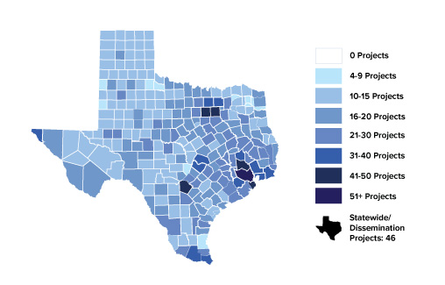
Prevention Program
Services & Geographic Coverage
COUNTIES OF RESIDENCE OF PEOPLE SERVED BY CPRIT PREVENTION PROJECTS
Over 7.8 Million Education
and Clinical Services
4.4 M Education & Training Services
3.4 M Clinical Services
Vaccinations
Tobacco Cessation
Screening: breast, cervical, colorectal
Genetic testing and counseling
  Survivor care
February 2022

Slide 17
Selected Program Examples
17

Slide 18
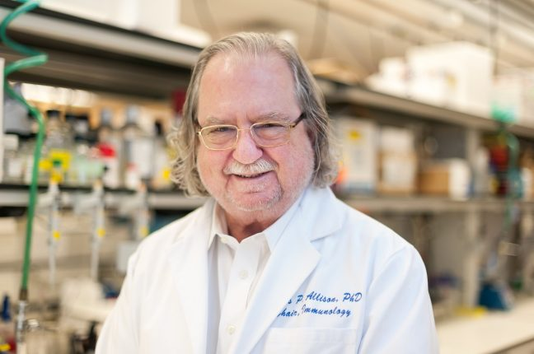
Expediting Innovation and Enhancing the Potential for Prevention and Cures
Jim Allison, Ph.D.
CPRIT Scholar
2018 Nobel Prize in
Physiology or Medicine
“Texas recognized the opportunity to accelerate discovery and basic science by investing $3B over 10 years through the Cancer Prevention and Research Institute of Texas “
“Biotech and pharmaceutical companies, fund the late-stage research that brings well-developed therapies to clinical trial-and philanthropy also is quite helpful. But without the early funding of basic science from the government, many of the therapies that currently treat millions of cancer patients worldwide simply wouldn’t exist”.
February 2022

Slide 19
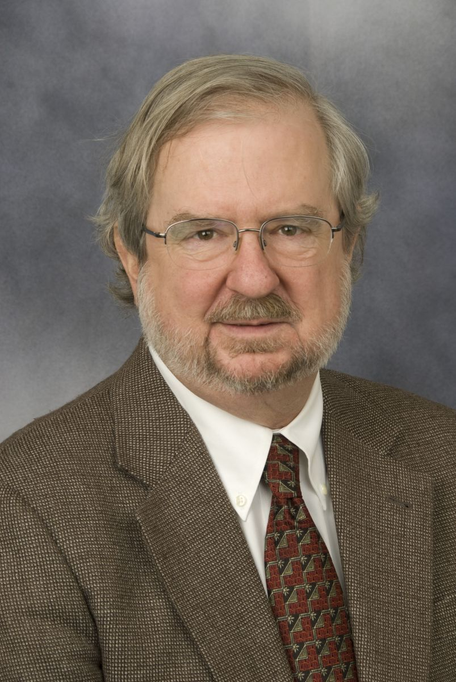
Recruitment of Established Investigators
James Allison, Ph.D.
MD Anderson Cancer Center
PROGRAM
CPRIT’s Established Investigators program recruits senior research faculty with distinguished professional careers and established cancer research projects. Since 2011, CPRIT funding has brought 49 senior researchers to Texas institutions.
CPRIT Award: $10 million
SCHOLAR RECRUIT
Dr. Allison is considered the father of modern-day immunotherapy, which unleashes the body’s own immune system to attack cancer. Recruited to MD Anderson from Memorial Sloan Kettering to serve as chair of Immunology and executive director of the Immunotherapy Platform (2011). Recipient of the 2018 Nobel Prize in Physiology or Medicine for launching an effective new way to attack cancer by treating the immune system rather than the tumor.
Outcomes
Impact
Clinical trials are underway using immunotherapy to treat prostate cancer, which killed Dr. Allison’s brother in 2005.
Allison’s basic science discoveries on the biology of T cells, the adaptive immune system’s soldiers, and his invention of immune checkpoint blockade to treat cancer established an entirely new principle for cancer therapy that has transformed cancer care.
Discovered a protein, CTLA-4, that acts as a brake on people’s immune responses. Before, scientists had assumed it was an accelerator.
Found a way to remove the brake so that T cells, the warriors of the immune system, can go after cancer cells and destroy them.
February 2022

Slide 20
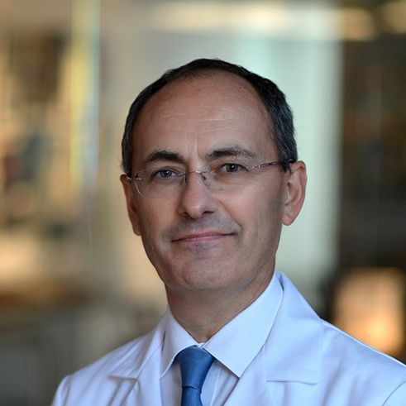
Recruitment of Established Investigators
Matthew Ellis, MB BChir, Ph.D.
Baylor College of Medicine
CPRIT Award: $6 million
PROGRAM
CPRIT’s Established Investigators program recruits senior research faculty with distinguished professional careers and established cancer research projects. CPRIT funding has brought 49 senior researchers to Texas institutions.
SCHOLAR RECRUIT
Dr. Matthew Ellis is a top physician who sees breast cancer patients every week, as well as a researcher working at the forefront of understanding the genomics of breast cancer. In 2014, he moved from Washington University to become the director of the Lester and Sue Smith Breast Center at Baylor College of Medicine. Dr. Ellis was the recipient of the 2015 American Society of Clinical Oncology's Gianni Bonadonna Breast Cancer Award.
Outcomes
Impact
To help clinicians decide on the best treatment for their patients, he is developing an atlas of genetic mutations present in breast cancers along with information on how these mutations respond to treatment.
Dr. Ellis and his colleague, Bing Zhang, Ph.D., also a CPRIT scholar recruited to Baylor, received $11 million from the NIH to establish a new Translational Research Center to unite the genomics of breast cancer with understanding the proteins that mutated genes code for. This cutting-edge proteogenomic center is the first of its kind in Texas.
Pioneer in breast cancer genomics. He has identified groundbreaking new information about mutations in breast cancer and their clinical relevance.
First large-scale proteogenomic study of breast cancer, linking DNA mutations to protein signaling and helping pinpoint the genes that drive cancer.
February 2022
20

Slide 21


Expediting Innovation to Cure Ovarian Cancer
Dr. Livia Eberlin received the MacArthur Genius Award for the MasSpec pen. Her work involves ovarian cancer.
Early detection of ovarian cancer is the most effective way to a cure. Unfortunately, only 15% of cases are diagnosed early, making ovarian cancer a notorious “silent killer”. CPRIT invests in new techniques for early detection and initial treatment of ovarian cancer.
Momentum
Outcome
CPRIT prevention, research and company awards related to ovarian cancer exceeds $160M.
5,444 women have participated in a CPRIT supported clinical trial designed to optimize use of CA125 for early detection of ovarian cancer in low-risk women.
CPRIT supports development of a blood test to detect early-stage ovarian cancers and improve the likelihood of cure with surgery.
Texans from 103 of 254 (40%) counties have benefited from CPRIT’s active genetic testing programs.
CPRIT supports a UT Austin and MD Anderson partnership to develop the MasSpec Pen to identify ovarian cancer cells during surgery.
Aravive Biologics received FDA Fast Track Designation and conducts a clinical trial of its novel agent developed with CPRIT support to overcome chemotherapy resistance in ovarian cancer.
CPRIT Prevention awards support screening, diagnosis and navigation of Texans at high genetic risk for developing ovarian cancer.
OncoNano Medicine conducts clinical trials of an intraoperative fluorescence imaging agent developed with CPRIT support to improve surgical management of ovarian and other cancers.
CPRIT has recruited 2 world class ovarian cancer researchers to Texas institutions.
February 2022
21

Slide 22
New Horizons in Childhood Cancer Prevention and Research
CPRIT-funded Centers of Excellence establish Texas as a national leader discovering
more effective ways to prevent and cure childhood cancers
11% of CPRIT’s portfolio goes to childhood cancer projects—proportionately 3 times the national rate
Momentum
Targeting multiple cancer types impacting children
  Neuroblastoma – CPRIT supported development of new treatments for neuroblastoma has been translated to clinical trials with promising impact on survival.
  Leukemia – Cellular Therapy for the Treatment of Children and Adults with AML
  Ewing’s Sarcoma – Over $20M in funding for rare bone cancer with limited treatment
  Brain cancer – Over $46M in funding for childhood brain cancer research, spanning bench, translational and product development research.
Survivorship – Online Patient-Centered Decision Support Service to Empower Childhood Cancer Survivors in Managing Screening and Prevention of Late Effects of Treatment
New Opportunities
Pediatric clinical trials consortium to increase access to curative immunotherapy, precision therapies, and novel diagnostic capabilities
Statewide informatic and genomic pediatric cancer resources to enable “Big Data” strategies to understand and cure childhood cancers
Multi-institutional “dream teams” for childhood brain cancers and pediatric sarcomas
Vaccinate all Texans age 9 to 26 against HPV-associated cancers
With continued support and capitalizing on CPRIT’s longstanding investment in improving outcomes,
Texas is poised to be the world leader in childhood cancer research
February 2022
22

Slide 23
Creating a Cancer Fighting Ecosystem:
Expanding Clinical Trials
CPRIT is expanding its funding for clinical trials to speed development of promising drugs and
increase patient access to groundbreaking therapies
    32,621 patients enrolled in 197 clinical trials or studies
    43 biotech companies started, expanded, or brought to Texas; 20 of these companies are conducting active clinical trials for novel cancer diagnostics and therapies
    3 NCI Comprehensive Cancer Centers, in addition to other state-of-the-art facilities across the state, are actively conducting CPRIT-funded clinical trials
New Opportunities
Expand access across Texas to cell-based immunotherapy and other innovative treatment options
Increase participation in clinical trials
Improve clinical trial access for patients in Texas battling life-threatening cancers with limited treatment options
Specific RFAs to increase collaboration on innovative clinical trials across Texas
Collaborative early phase pediatric clinical trials
RFA supporting the recruitment of clinical investigators (clinical trialists) to Texas
Momentum
CPRIT-funded trials span multiple cancer types: solid tumors, ovarian, liver, lung, brain, leukemia, rare pediatric cancers and others → expanding patient access to novel treatment options
CPRIT-funded immunotherapy clinical trials open a new front in the fight against cancer → 26% of all advanced cancers have responded to immunotherapy, leading to significant improvements in 5-year survival.
AVID100 demonstrated a compelling profile in preclinical and Phase 1 clinical studies, and this significant CPRIT grant supports and accelerates development of this agent for several cancers with unmet medical needs.
-Ilia A. Tikhomirov, CEO of Formation Biologics, on their novel cancer drug AVID100
February 2022
23

Slide 24

Expanding Capabilities and Expediting Innovation : Core Facilities
“Proteomics & Metabolomics Core Facility”
Baylor College of Medicine, CPRIT Award: $6,000,000
”
Provides consultation, instrumentation, technical support and data analysis for cancer research projects focused on metabolomics and proteomics – the study of global changes in cellular metabolites and proteins.
Outcomes
Impact
82 new cancer research grants totaling more than $96M from agencies such as NIH, DOD, and ACS have resulted from preliminary data generated by the Core Facility.
A center of excellence with high-end instrumentation and state-of-the-art technologies for discovery of protein and metabolic networks relating to cancer.
The Core Facility has supported the projects of more than 110 different cancer researchers
Research discoveries include identification of novel drivers of different cancer subtypes, resistance mechanisms to enable development of alternative therapies, and new therapeutic targets for drug development.
More than 124 high impact publications in top tier journals including Cell, Science, and Nature.
“Discoveries have begun to lead to development of drugs to novel therapeutic targets. As the Core Facility matures, we anticipate more of these outcomes including clinical studies designed to improve treatments and well-being of patients. None of the above accomplishments would have been possible without CPRIT support.”
Dean P. Edwards, Ph.D., Principal Investigator
Professor, Molecular & Cellular Biology and Pathology & Immunology
February 2022
24

Slide 25

ACT: Alliance for Colon Cancer Testing 2.0, A Regional and Statewide Collaboration
The University of Texas MD Anderson Cancer Center
NEED
Colorectal cancer (CRC), the second leading cause of cancer deaths in the United States and the State of Texas, is curable if detected in its early stages, but often fatal when diagnosed later. Studies have shown that CRC screening (CRCS) for the detection and treatment of early cancer, as well as the removal of precursor adenomatous polyps, is effective in reducing CRC incidence and mortality. According to the Agency for Healthcare Research and Quality (AHRQ), only half of all adults aged 50-75 have ever received age-appropriate CRCS, and in minority populations, that number drops to 30%.
CPRIT Award: $4,034,507
(March 2018 – February 2021)
PD: Lewis Foxhall, MD
ACT PROGRAM
Through partnerships developed with clinics that serve CPRIT Priority Populations, the program distributes Fecal Immunochemical Stool Test (FIT) kits. Patients with positive results are navigated to a community endoscopist who performs the recommended follow-up colonoscopy. The program is based on the methodology of an earlier program funded through Medicaid waiver 1115 (FIT-Flu) and expands it to 53 counties.
Outcomes
Impact
As of 6/15/2020:
26,185 FIT kits have been distributed to under/uninsured patients
17,828 kits were returned by patients and resulted (processing funded by CPRIT)
1,326 colonoscopies funded by CPRIT
612 of the patients who received colonoscopies had precancerous polyps removed
39 patients have been diagnosed with CRC and have been navigated to treatment
Participating health clinics are adopting modern screening methods and making them available to both insured and uninsured patients.
This program has raised screening rates of uninsured patients between 8 and 30% in participating clinics.
“Thank you for this program, it has helped me greatly! I didn’t know I had cancer because I had no symptoms. When I went in for a checkup at my clinic they gave me a kit and the result was positive. I’m very thankful for the program, the cancer would have been fatal if it weren’t discovered.” –ACT Patient in Brazoria County

Slide 26

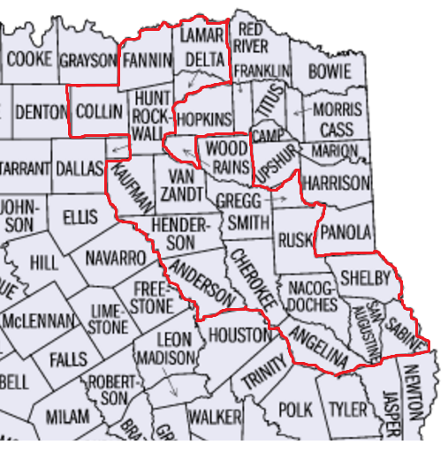

Optimizing Colorectal Cancer Screening in East Texas
NEED
Nationally, 40% of men and women > 50 years old have not undergone CRC screening. In Texas, screening rates are far lower for individuals without health insurance than overall [6.8% vs 9.1% for stool blood testing in the past year, 28.1% vs. 57.8% for endoscopy (flexible sigmoidoscopy and colonoscopy)]. Both incidence and mortality rates from 2002-11 were higher in East Texas than the state as a whole. The 19 counties in our proposed catchment area have a higher percentage of adults > 50 years old than Texas as a whole, and almost one third of adults < 65 years old are without insurance.
CPRIT Award PP160023: $2,299,753.00
(August 2016 – February 2020)
PD: Paul McGaha, DO, MPH
Co-PD: Carlton Allen, MS, CHW, CHES
PROGRAM
This proposal expands our currently funded colorectal cancer (CRC) screening project from 7 to 19 primarily rural counties in East Texas, an area with a high incidence and mortality from CRC. It has been designed to reach and serve as many people as possible, partnering with hospitals, federally qualified health centers (FQHCs), public health districts, health departments, charity clinics, community and faith-based organizations. The current proposal provides services for less cost than our previously funded CRC screening project and has a robust educational component.
"If precancerous polyps are detected early, colorectal cancer is very preventable,“ – Dr. Paul McGaha
Outcomes
Impact
6,423 total Colorectal Cancer screenings over the lifetime of the project. 1,580 of those screenings being coloscopies that detected 98 precursors and cancers.
The project has demonstrated a positive return of investment from $1.88-2.74.
Over 146,000 individuals reached and over 16,000 provided with CRC screening risk-benefit education.
Procedures for navigating un- and under-insured individuals to available resources have become an integral part of participating clinics’ workflow.
East Texas Clinics developed workflow and patient outcome tracking procedures to allow identification and appropriate follow-up with patients eligible for CRC screenings.
HSR 4 (Northeast Texas) dropped from 4th to 3rd quartile for colon and rectal cancer incidence and mortality according to TCR data.
Five manuscripts published to numerous journals including: Journal of Immigrant and Minority Health, PharmacoEconomics-Open, and Cancer Health Disparities Journal.
Year | Number of FITs | Number of Colonoscopies | Number of precursors/cancers detected
2016-2017 | 1,410 | 665 | 46
2017-2018 | 1,533 | 536 | 31
2018-2019 | 1,900 | 379 | 21
Total | 4,843 | 1,580 | 98

Slide 27

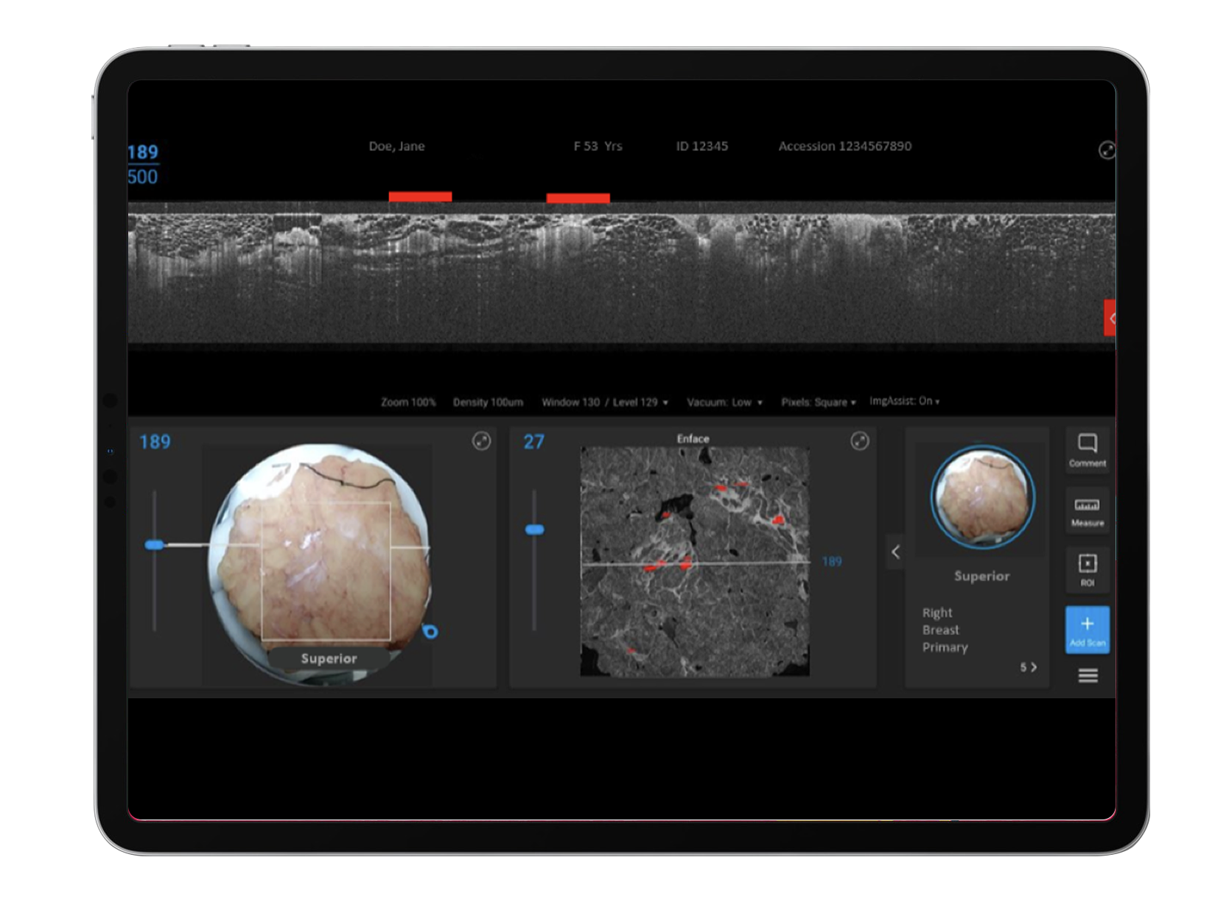
Creating a Cancer Fighting Ecosystem
CPRIT Award: $7,446,844
(August 2019)
PROJECT: Perimeter is developing a medical imaging technology with AI that will be initially used during breast cancer surgery to help ensure that all the cancerous tissue is removed in one attempt.
DISEASE: Breast, colorectal, head and neck
SIGNIFICANCE: Unfortunately, today many breast cancer patients between 10-40% must undergo a second operation due to cancer being left behind unknowingly by the surgeon. Perimeter’s technology allows the surgeon to image the surface of excised tissue at the time of surgery at very high resolution. This will give the surgeon the opportunity to remove additional tissue at the time of first surgery and in return potentially reduce the number of second surgeries.
Dallas, TX and Toronto, Ontario
Highlights
The FDA has granted the company breakthrough device designation for its optical coherence tomography (OCT) imaging system coupled with ImgAssist AI Perimeter’s proprietary “ImgAssist” AI technology has now been trained with more than 400 volumes of images of excised breast tissue collected during the first stage of its ATLAS AI project. Commitment to Texas: company has formed alliances with Baylor College of Medicine, MD Anderson and UT Health San Antonio
“The CPRIT award has had a tremendous positive effect across many areas of Perimeter’s product development. So far, the funds awarded have been used to acquire crucial data sets that have trained our AI algorithms to be more accurate in preparation for a large Pivotal study where we intend to demonstrate that our technology can reduce the number of second surgeries for breast cancer patients.”
- Andrew Berkeley, Co-Founder, Perimeter Medical Imaging
February 2022

Slide 28

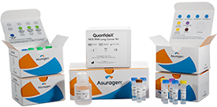
Creating a Cancer Fighting Ecosystem
PROJECT: CPRIT supported the development of easy-to-use kits that report patients’ genetic information in tumors using next-generation sequencing (NGS). This information can help guide therapy and targeted treatments and improve patient management and outcomes.
DISEASE: multiple cancer types
SIGNIFICANCE: CPRIT helped to fund the development of multiple novel next-generation sequencing products developed at Asuragen. These products include both reagents and bioinformatics software, span both DNA and RNA sequencing, and are used for both clinical research and in vitro diagnostics. These kits are used to diagnose mutations in multiple types of solid tumors, including lung, colon, and breast cancers.
CPRIT Award: $6,837,265
(March 2012)
Austin, TX
Highlights
The work funded by CPRIT resulted in 10 peer-reviewed scientific papers and have garnered >500 citations since they’ve been published, including one article in the Journal of Molecular Diagnostics that was formally recognized as one of the most highly cited articles over several years. Acquired by Bio-Techne Corporation April 2021 for $215 million plus potential earn-outs
“CPRIT support led to technology development that Asuragen could not have readily achieved otherwise. By developing this technology, Asuragen was able to launch several cutting-edge NGS products that address personalized medicine in oncology.”
- Gary Latham, PhD, SVP Research and Development
February 2022

Slide 29
Questions?
www.cprit.texas.gov
PO Box 12097 Austin Texas 78711 (512) 463-3190
Wayne R. Roberts
Chief Executive Officer
Academic Research Program
Michelle Le Beau, Ph. D.
Chief Scientific Officer
Product Development Research Program
Ken Smith, Ph. D.
Chief Product Development Officer (Interim)
Prevention Program
Ramona Magid
Chief Prevention Officer
Strategic Initiatives
Tracey Davies
Chief Strategic Initiatives & Intellectual Property Officer
Legal
Kristen Doyle
Deputy Executive Officer & General Counsel
Operations
Heidi McConnell
Chief Operating Officer
Compliance
Vince Burgess
Chief Compliance Officer
Media & Public Relations
Mark Dallas Loeffler
Communications Director

